Slide 1

Preparation for Lab 4
Week 8
Semester 1, 2025
Dr. Farshid Keivanian

Slide 2
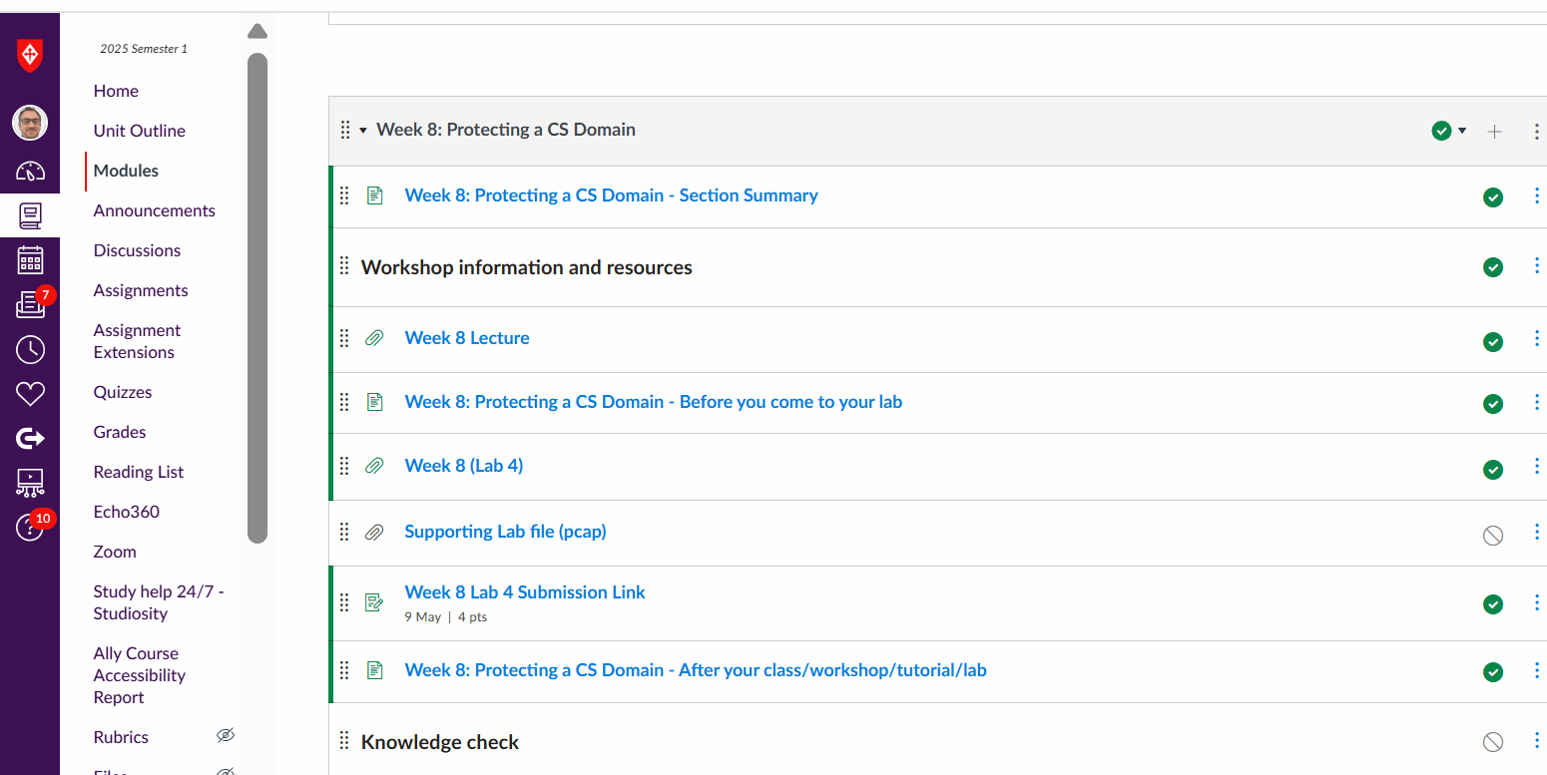
Preparation for Lab 4 (Week 8)
Navigate Canvas >> Week 8 >> Lab 4

Slide 3
Introduction
Welcome to Lab 4! This week, we're putting together important parts of cybersecurity like puzzle pieces:
Hash Functions = Making data fingerprints
Digital Signatures = Making online signatures for proof
ElGamal Signature = How real-world secure messaging works
OpenSSL Hashing = Hands-on with tools hackers and defenders both use!

Slide 4
Introduction
Think of this lab like building security locks:
Hashing = fingerprint locks
Digital signatures = handwritten signatures
OpenSSL = your real-world toolkit

Slide 5
Goals and What You Will Learn
By the end of Lab 4, you will:
Understand what makes a good hash function
Understand preimage attacks and birthday attacks
Learn how digital signatures protect data
Perform ElGamal signature creation and verification
Use OpenSSL to hash and observe how tiny changes break security
Build critical cyber defense skills!

Slide 6
Theory Background
1. Hash Functions
They convert any data into a unique fixed-length code (like a fingerprint).
Good hash functions should be:
Fast
Hard to reverse
Collision-resistant (two messages shouldn’t have the same hash)

Slide 7
Theory Background
2. Preimage Attack
Trying to find a message that matches a given hash.
For a good n-bit hash, you need about 2ⁿ tries.
(e.g., 2¹²⁸ for a 128-bit hash!)

Slide 8
Theory Background
3. Birthday Attack
Just like in a class, where two people might share a birthday surprisingly quickly.
In cybersecurity, it means finding two messages that hash to the same value.
Needs about 2ⁿ/ ² tries.

Slide 9
Theory Background
4. Digital Signatures
Prove who sent a message and that it was not changed.
Example: Signing an online contract via DocuSign.
Properties:
Authenticity (you really sent it)
Integrity (unchanged)
Non-repudiation (you can’t deny it later)

Slide 10
Theory Background
5. ElGamal Digital Signature
Uses math magic (modular arithmetic) to create a signature.
Others can verify the signature without seeing your private key!

Slide 11
Lab 4 Structure and Step-by-Step Instructions
Part 1: Theory Questions (Written Answers)
List and explain key requirements of a hash function.
Calculate effort needed for preimage attack (half success).
Explain birthday attack and effort needed (half success).
List applications and properties of digital signatures.
Briefly explain ElGamal signature generation and verification.
Goal: Strengthen your understanding of core concepts.

Slide 12
Lab 4 Structure and Step-by-Step Instructions
Part 2: Challenge Exercise – ElGamal Digital Signature
You are given:
Public Key = {q = 13, a = 2, YA = 8}
Private Key = {XA = 3}
Message = {M = 11}
Random K = 5
Goal: Generate and verify a digital signature.

Slide 13

Lab 4 Structure and Step-by-Step Instructions
Step 1: Find $r$
$r=a^{K} mod q$
$r=2^{5} mod 13$
$r=32 mod 13$
$r=6$

Slide 14






Lab 4 Structure and Step-by-Step Instructions
Step 2: Find $K^{−1} mod (q−1)$ (modular inverse)
$q−1=12$
$K=5$
$5^{−1} mod 12$
In Step 2, we need to find the modular inverse of $K=5$modulo $q−1=12$.
The modular inverse of 5 (mod 12) is a number that, when multiplied by 5, gives a result of 1 mod 12.
So we are solving:
$5×x≡1 mod 12$
When we try $x=5$ :
$5×5=25$
$25 mod 12=1$

Slide 15
Lab 4 Structure and Step-by-Step Instructions
Step 2: Find $K^{−1} mod (q−1)$ (modular inverse)
$q−1=12$
$K=5$
$5^{−1} mod 12$
So, 5 is its own modular inverse under mod 12.
Simple analogy: It’s like asking: “What number should I multiply by 5 so that after dividing by 12, the remainder is 1?” Answer: 5 itself!
$5×x≡1 mod 12$
When we try $x=5$ :
$5×5=25$
$25 mod 12=1$

Slide 16
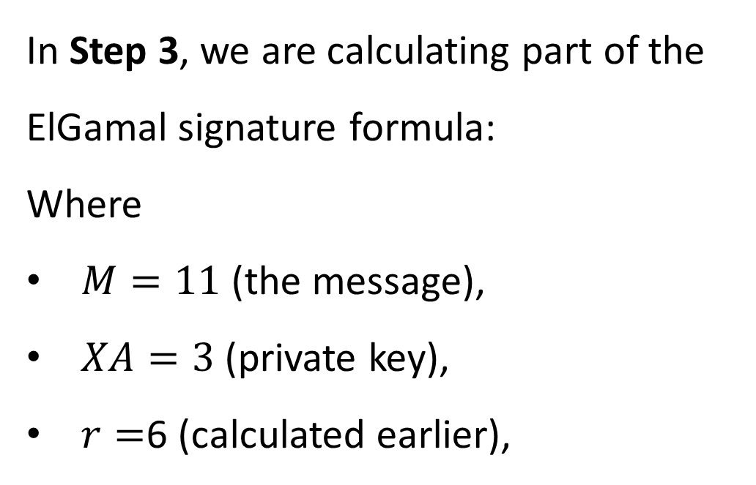
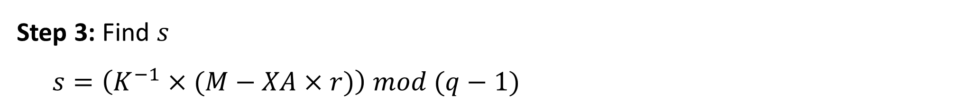
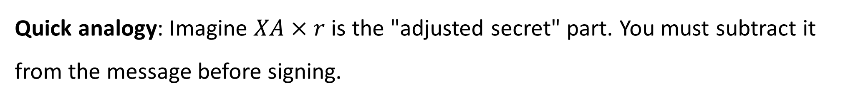
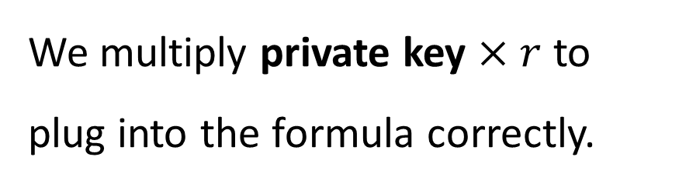
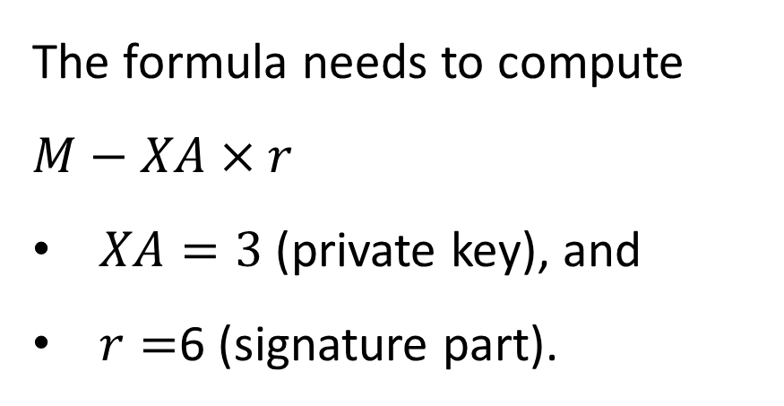
Lab 4 Structure and Step-by-Step Instructions
Step 3: Find $s$
$s=\left(K^{−1}×(M−XA×r)\right) mod (q−1)$
The formula needs to compute $M−XA×r$
$XA=3$ (private key), and
$r=$6 (signature part).
In Step 3, we are calculating part of the ElGamal signature formula:
Where
$M=11$ (the message),
$XA=3$ (private key),
$r=$6 (calculated earlier),
We multiply private key $×$ $r$ to plug into the formula correctly.
Quick analogy: Imagine $XA×r$ is the "adjusted secret" part. You must subtract it from the message before signing.

Slide 17


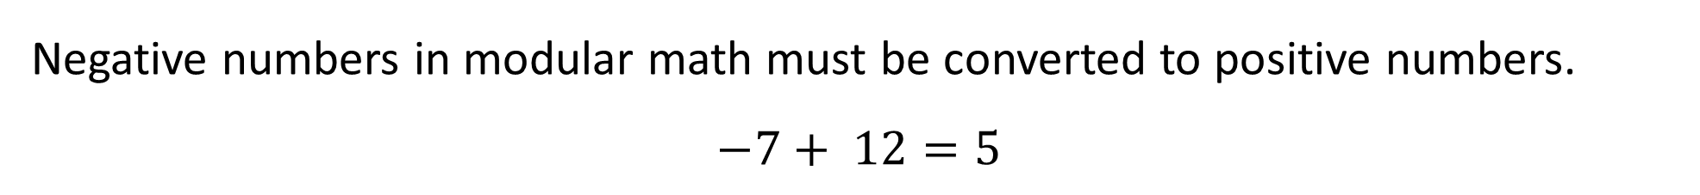
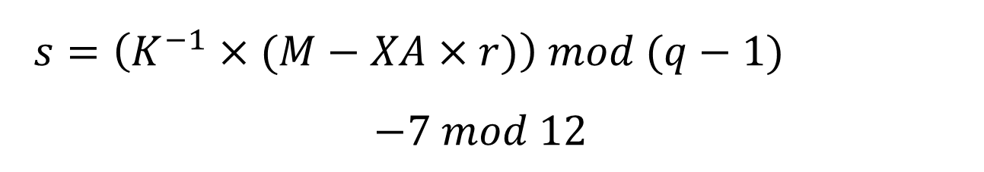
Lab 4 Structure and Step-by-Step Instructions
$M−XA×r$
$11−18=−7$
Analogy: Think of mod as wrapping negative numbers around a clock. If you’re 7 hours before 12 o'clock, you’re actually at 5 o'clock!
$q−1=12$
$s=\left(K^{−1}×(M−XA×r)\right) mod (q−1)$
$$−7 mod 12$$
Negative numbers in modular math must be converted to positive numbers.
$$−7+ 12=5$$

Slide 18



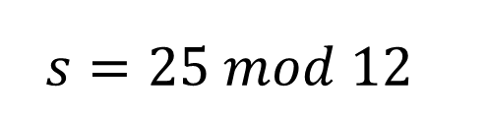

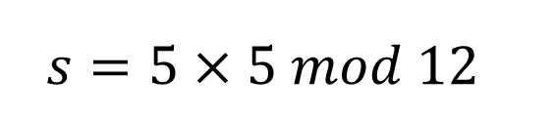
Lab 4 Structure and Step-by-Step Instructions
$K^{−1}=5 modular inverse from Step 2$
$So,$
$s=\left(K^{−1}×(M−XA×r)\right) mod (q−1)$
$$s=5×5 mod 12$$
$$s=25 mod 12$$
$$s=1$$

Slide 19
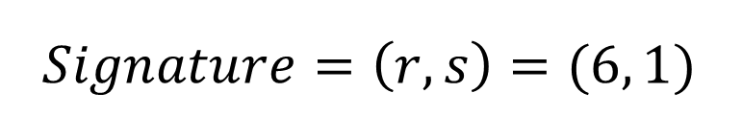

Lab 4 Structure and Step-by-Step Instructions
$$Final Signature:$$
$$Signature=\left(r, s\right)=(6, 1)$$

Slide 20


Lab 4 Structure and Step-by-Step Instructions
V$\text{erifying} \text{ElGamal} \text{Signature}\text{ (}r=6, s=1\text{)}$
Given:
$q=13$
$a=2$
$YA=8$
$r=6$
$s=1$
$M=11$
Now, let's calculate v1 and v2:

Slide 21
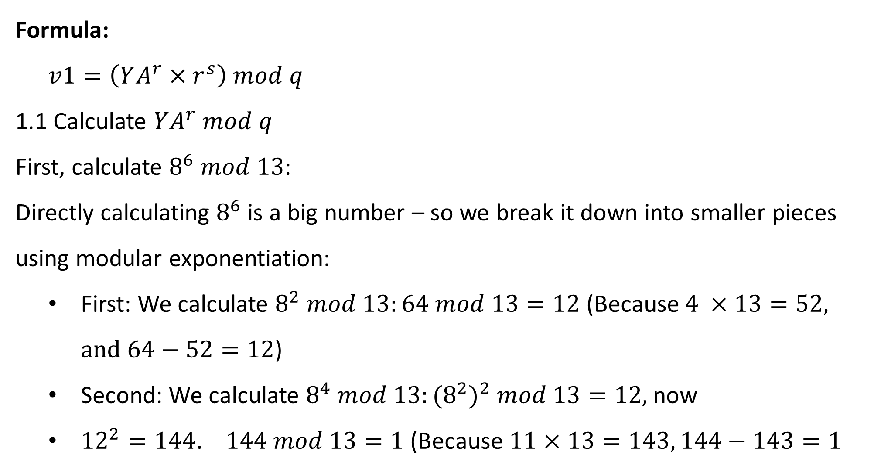
Lab 4 Structure and Step-by-Step Instructions
Formula:
$v1=\left(YA^{r}×r^{s}\right) mod q$
1.1 Calculate $YA^{r} mod q$
First, calculate $8^{6} mod 13$:
Directly calculating $8^{6}$is a big number – so we break it down into smaller pieces using modular exponentiation:
First: We calculate $8^{2} mod 13:64 mod 13=12$ (Because $4 ×13=52, and 64−52=12$)
Second: We calculate $8^{4} mod 13:{(8^{2})}^{2} mod 13=12,$now
${12}^{2}=144$. $144 mod 13=1$ (Because $11×13=143, 144−143=1$

Slide 22
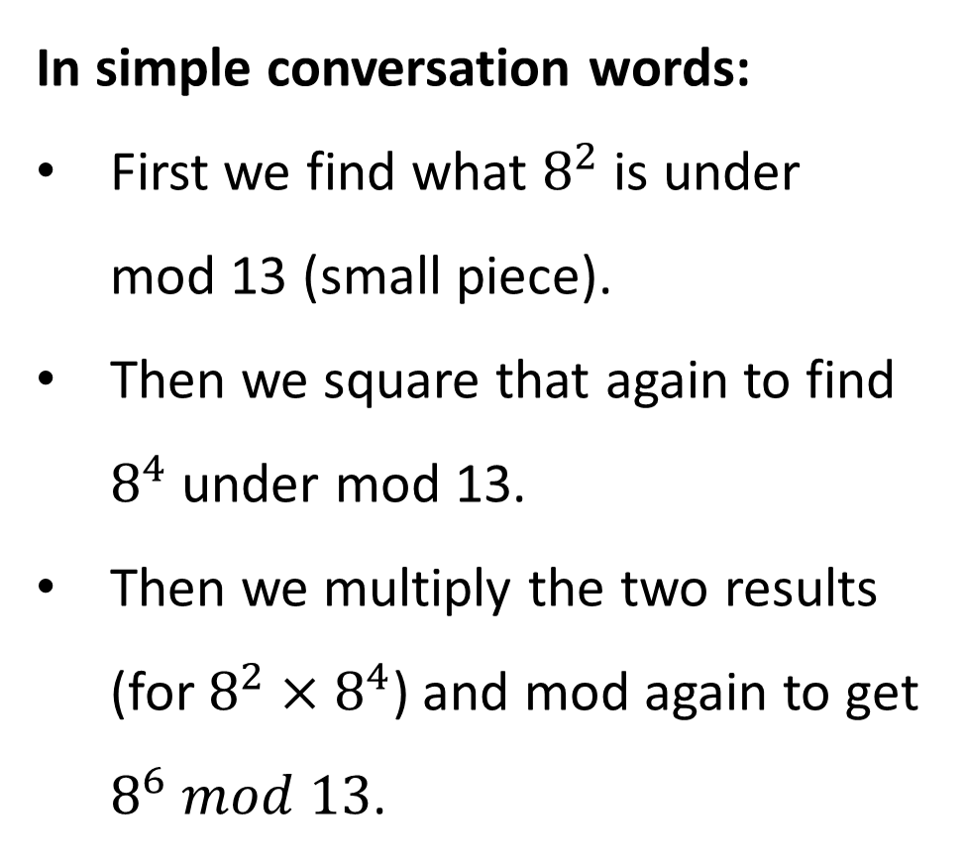

Third, now use:
$8^{6}=8^{2}×8^{4}$
We already now:
$8^{2} mod 13=12$
$8^{4} mod 13=1$
So:
$8^{6} mod 13=\left(12×1\right) mod 13=12$
Final answer: $8^{6} mod 13=12$
In simple conversation words:
First we find what $8^{2}$ is under mod 13 (small piece).
Then we square that again to find $8^{4}$ under mod 13.
Then we multiply the two results (for $8^{2}×8^{4}$) and mod again to get $8^{6} mod 13$.
Breaking powers apart like this is a trick to make life easier without huge numbers!

Slide 23

Lab 4 Structure and Step-by-Step Instructions
1.2 Calculate $r^{s} mod q$
Since $s=1$:
$r^{s}=6^{1}=6$
$6 mod 13=6$
So:
$r^{s} mod 13=6$

Slide 24

Lab 4 Structure and Step-by-Step Instructions
1.3 Multiply and mod again
Now:
$v1=\left(12×6\right) mod 13$
First:
$\left(12×6\right)=72$
Then:
72$mod 13=7$ (Because $5×13=65$, $72−65=7$)
Thus:
$v1=7$

Slide 25
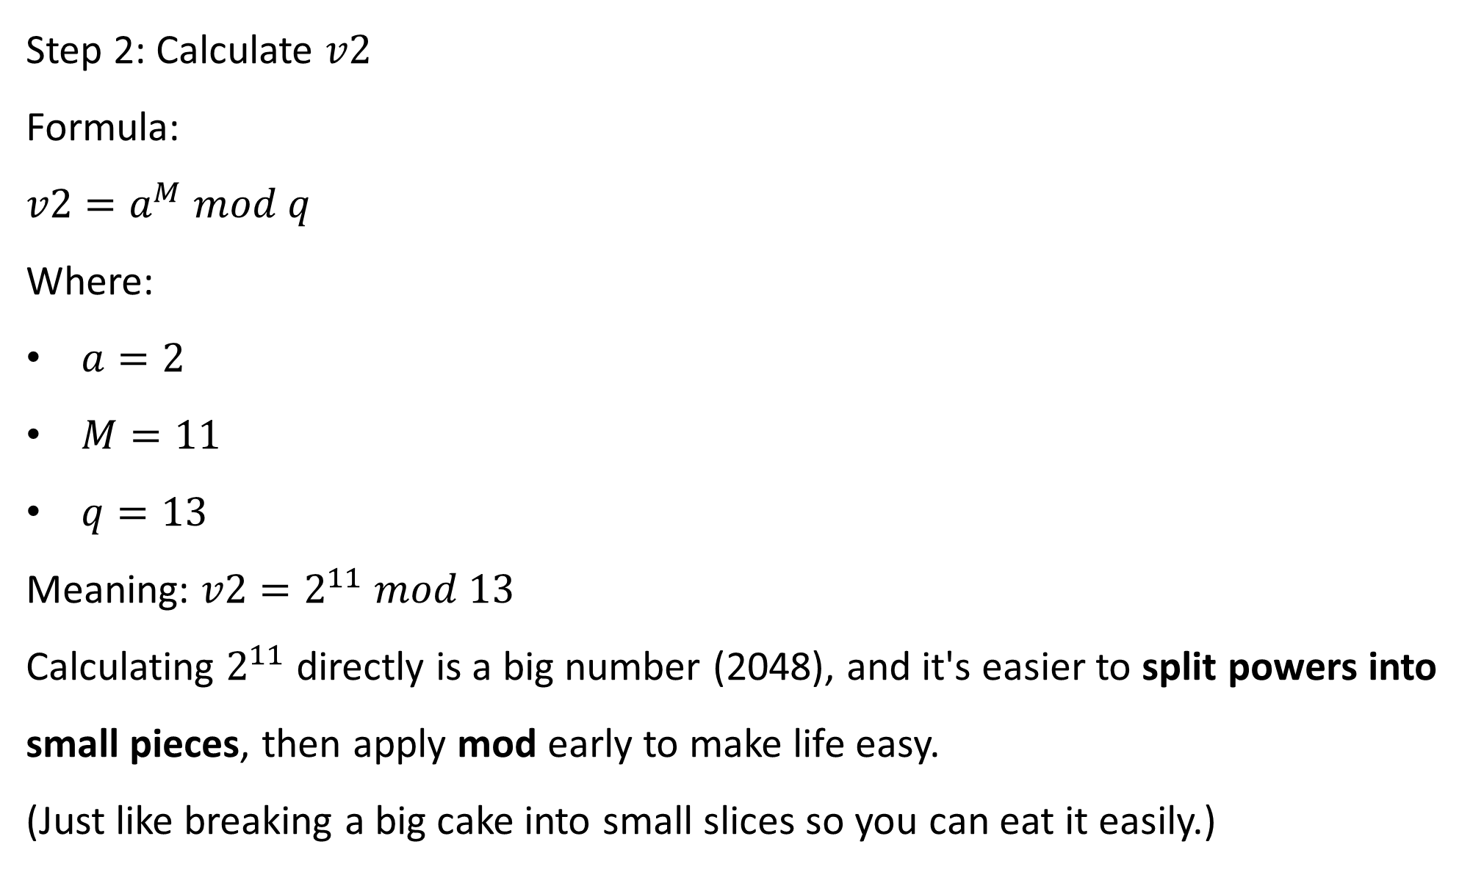
Step 2: Calculate $v2$
Formula:
$v2=a^{M} mod q$
Where:
$a=2$
$M=11$
$q=13$
Meaning: $v2=2^{11} mod 13$
Calculating $2^{11}$directly is a big number (2048), and it's easier to split powers into small pieces, then apply mod early to make life easy.
(Just like breaking a big cake into small slices so you can eat it easily.)

Slide 26
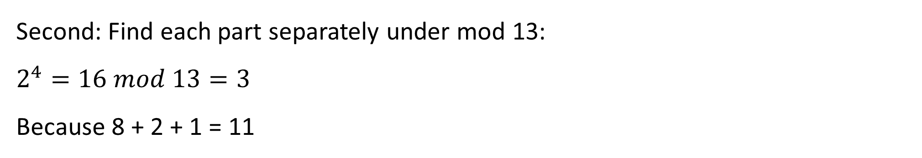
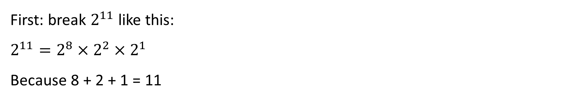

Lab 4 Structure and Step-by-Step Instructions
First: break $2^{11}$like this:
$2^{11}=2^{8}×2^{2}×2^{1}$
Because 8 + 2 + 1 = 11
Second: Find each part separately under mod 13:
$2^{4}=16 mod 13=3$
Because 8 + 2 + 1 = 11
Then $2^{8}={{(2}^{4})}^{2}$
Since:
$2^{4} mod 13=3$

Slide 27

Lab 4 Structure and Step-by-Step Instructions
Now:
$2^{8}=3^{2}=9 mod 13$
So:
$2^{8} mod 13=9$
Now quickly:
$2^{2}=4$
$2^{1}=$ 2

Slide 28
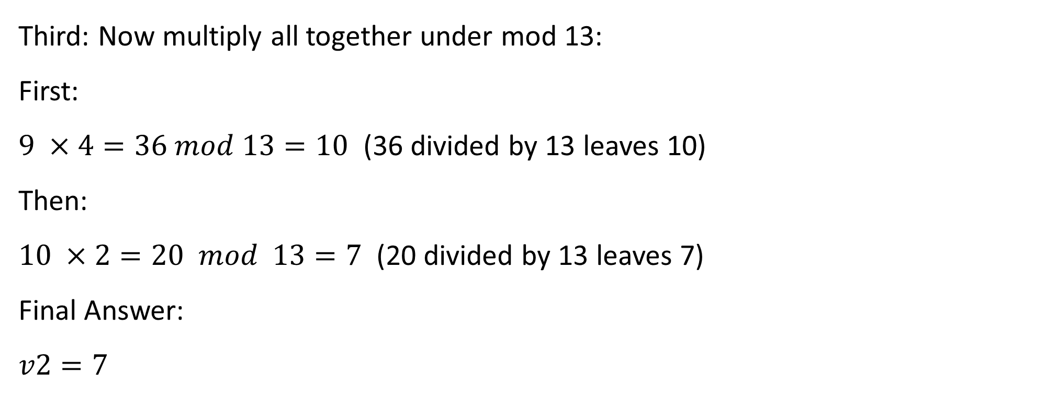
Lab 4 Structure and Step-by-Step Instructions
Third: Now multiply all together under mod 13:
First:
$9 ×4=36 mod 13=10$ (36 divided by 13 leaves 10)
Then:
$10 ×2=20 mod 13=7$ (20 divided by 13 leaves 7)
Final Answer:
$v2=7$

Slide 29
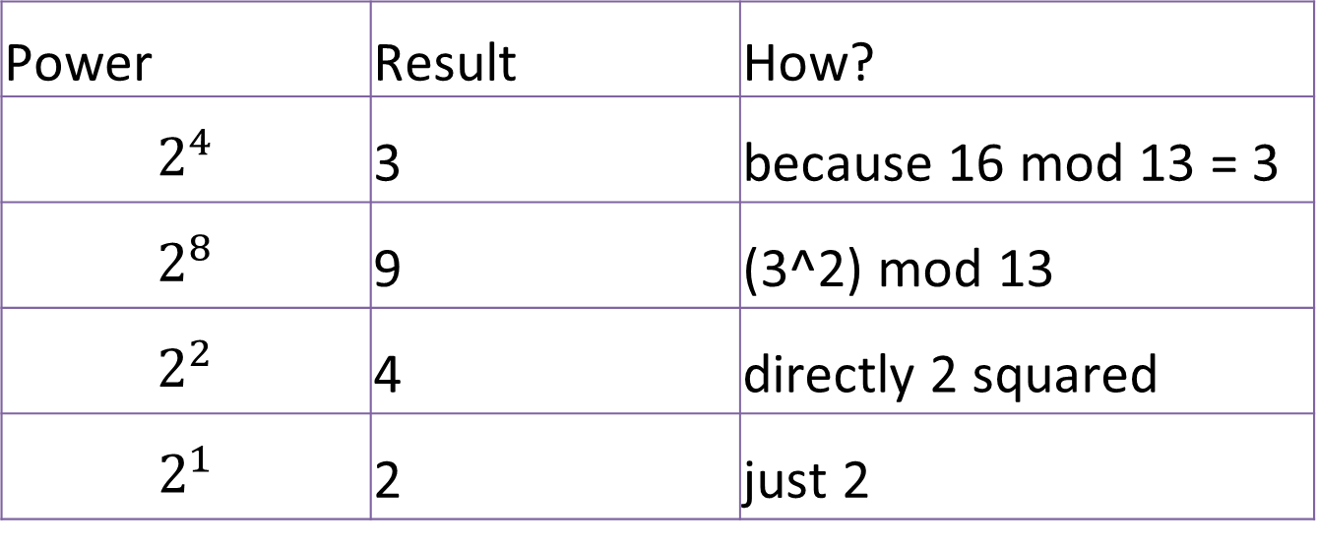
Lab 4 Structure and Step-by-Step Instructions
Quick Summary Table
Power | Result | How?
$$2^{4}$$ | 3 | because 16 mod 13 = 3
$$2^{8}$$ | 9 | (3^2) mod 13
$$2^{2}$$ | 4 | directly 2 squared
$$2^{1}$$ | 2 | just 2

Slide 30
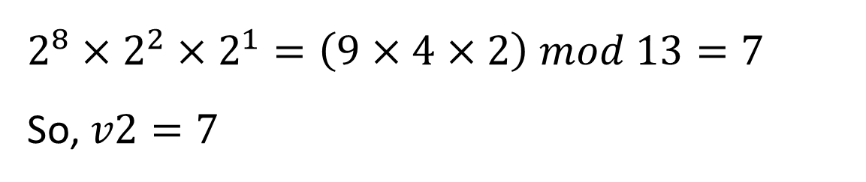
Lab 4 Structure and Step-by-Step Instructions
Final
$$2^{8}×2^{2}×2^{1}=\left(9×4×2\right) mod 13=7$$
So, $v2=7$
Break powers into small ones
Do mod early for each
Multiply small results and mod again

Slide 31
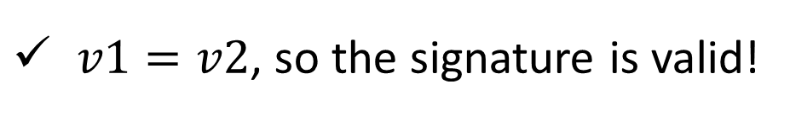
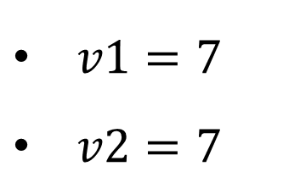
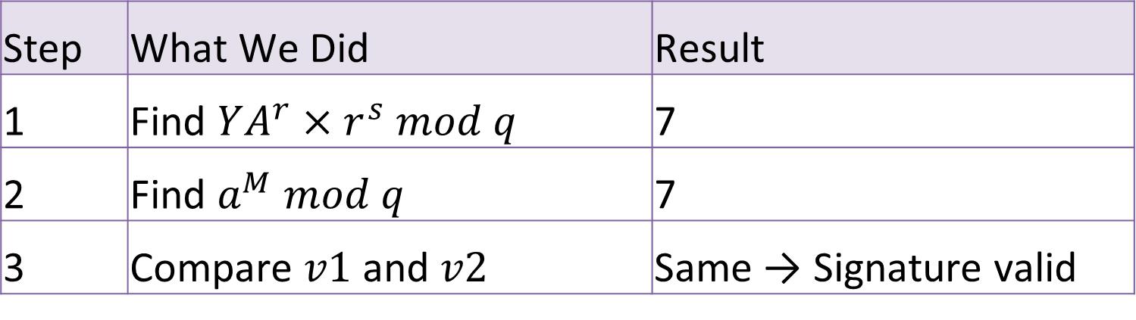
Lab 4 Structure and Step-by-Step Instructions
Final Check
$v1=7$
$v2=7$
$v1=v2$, so the signature is valid!
Quick Summary:
Step | What We Did | Result
1 | Find $YA^{r}×r^{s} mod q$ | 7
2 | Find $a^{M} mod q$ | 7
3 | Compare $v1$ and $v2$ | Same → Signature valid

Slide 32
Part 3: Hashing with OpenSSL in Kali Linux
Verifying Data Integrity using Hashing Techniques (OpenSSL in Kali Linux)
In this lab, we will explore how cryptographic hash functions work to ensure data integrity. You will:
Create a text file and insert sample content.
Generate MD5 and SHA-1 hashes using OpenSSL.
Modify the file slightly and observe how the hash changes.
Reflect on how hashing supports cybersecurity practices, such as tamper detection and integrity checks.

Slide 33
Part 3: Hashing with OpenSSL in Kali Linux
Verifying Data Integrity using Hashing Techniques (OpenSSL in Kali Linux)
This hands-on task builds foundational skills used in real-world systems for secure communication, digital signatures, and file verification.

Slide 34
Roadmap – What You’ll Do Today
Step | Activity
Step 1 | Launch Kali Linux (via VirtualBox)
Step 2 | Create a text file (student_id.txt) with given content
Step 3 | Open Terminal and navigate to home directory

Slide 35
Roadmap – What You’ll Do Today
Step | Activity
Step 4 | Display file content using cat command
Step 5 | Generate initial MD5 hash: openssl md5 student_id.txt
Step 6 | Edit the file (change a word) and save

Slide 36
Roadmap – What You’ll Do Today
Step | Activity
Step 7 | Recalculate hash and observe the difference
Step 8 | Try SHA-1 and SHA-256 hashing
Step 9 | Use Google to explore SHA-2 family and compare strengths

Slide 37
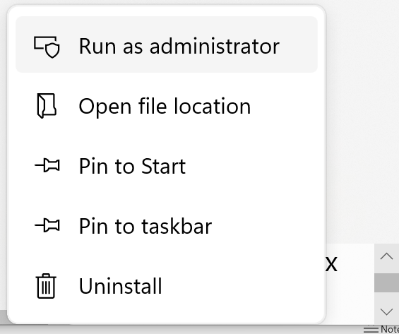
Lab 4 Structure and Step-by-Step Instructions
Step 1: Open Oracle VirtualBox Manager and select Kali virtual machine (Kali)
Click on Start → We plan to turn on Kali Linux, and get to the Kali login screen or desktop

Slide 38
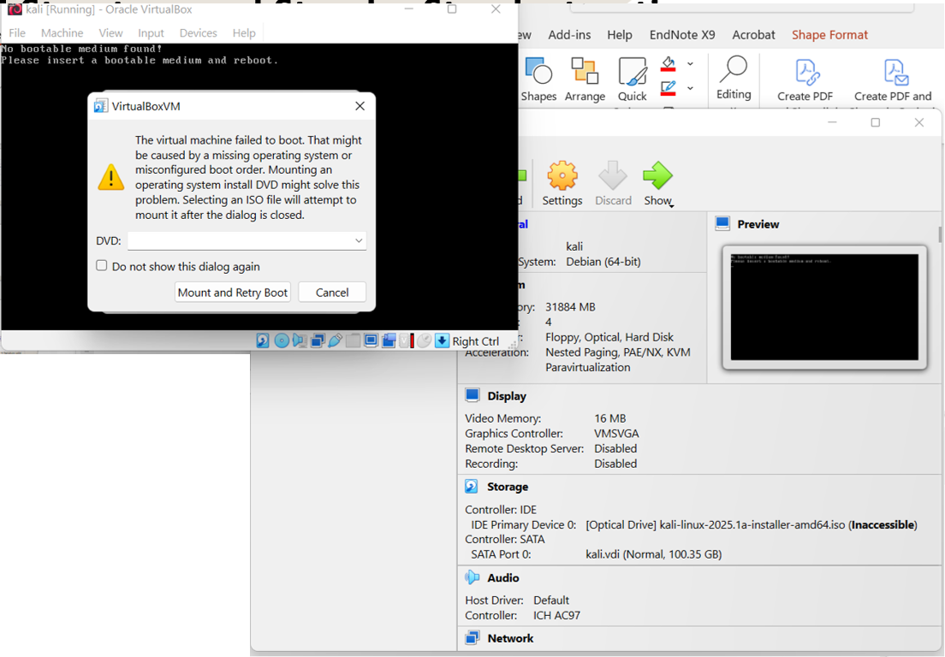
Lab 4 Structure and Step-by-Step Instructions
If the ISO file is corrupted, follow step-by-step instructions in Week 4 (Lab 2)

Slide 39
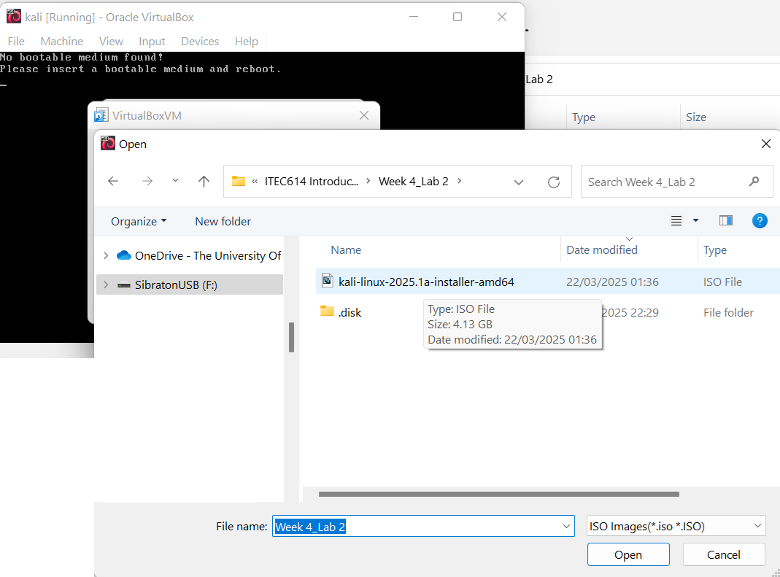
Lab 4 Structure and Step-by-Step Instructions
We do NOT need to create a new virtual machine from scratch again.
We already have the virtual machine "kali" created. (We can see it in our VirtualBox Manager.)

Slide 40
Lab 4 Structure and Step-by-Step Instructions
What we need to do is:
In the pop-up window that says "Mount and Retry Boot", YES, we should select our Kali Linux ISO file (kali-linux-2025.1a-installer-amd64.iso) that we downloaded in Lab 2.
After selecting it, click Mount and Retry Boot.

Slide 41
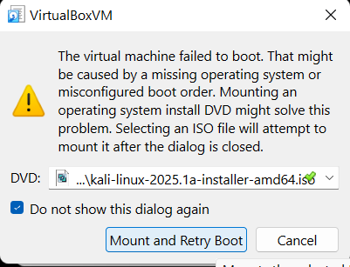
Lab 4 Structure and Step-by-Step Instructions

Slide 42
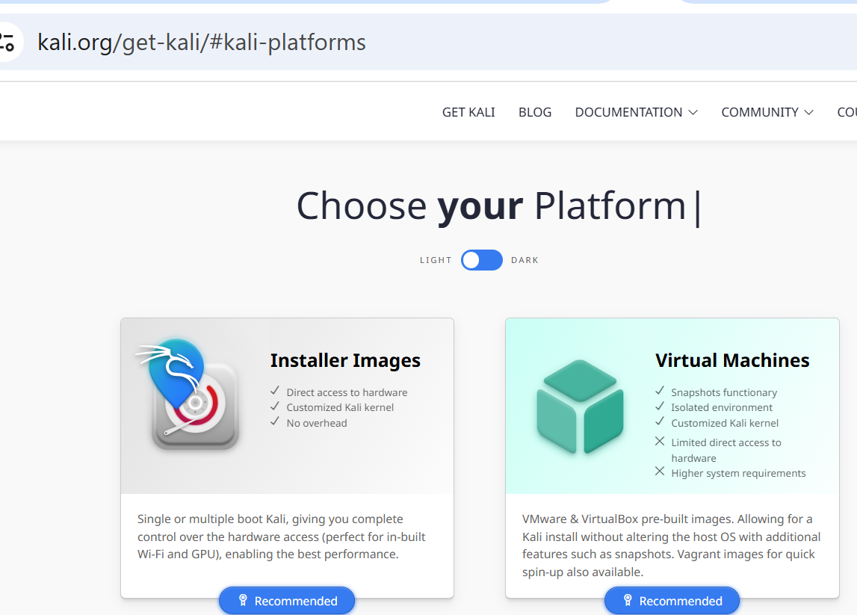
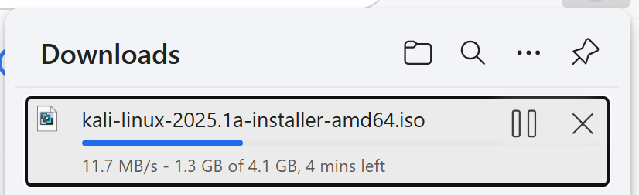
Lab 4 Structure and Step-by-Step Instructions
Recap: Remember we downloaded Kali Linux from (64-bit ISO file)
https://www.kali.org/get-kali/#kali-platforms

Slide 43
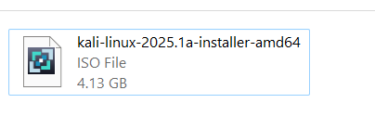
Lab 4 Structure and Step-by-Step Instructions
Recap: Remember we downloaded Kali Linux from (64-bit ISO file)
https://www.kali.org/get-kali/#kali-platforms

Slide 44
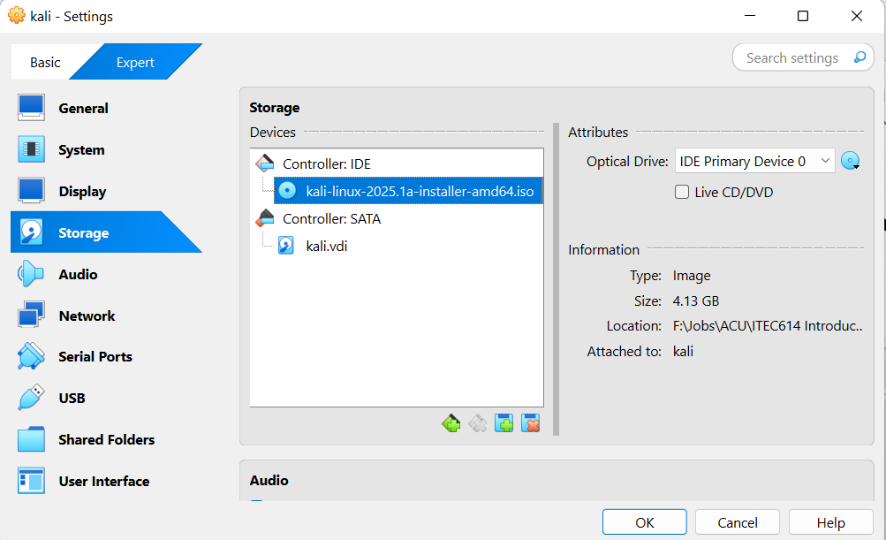
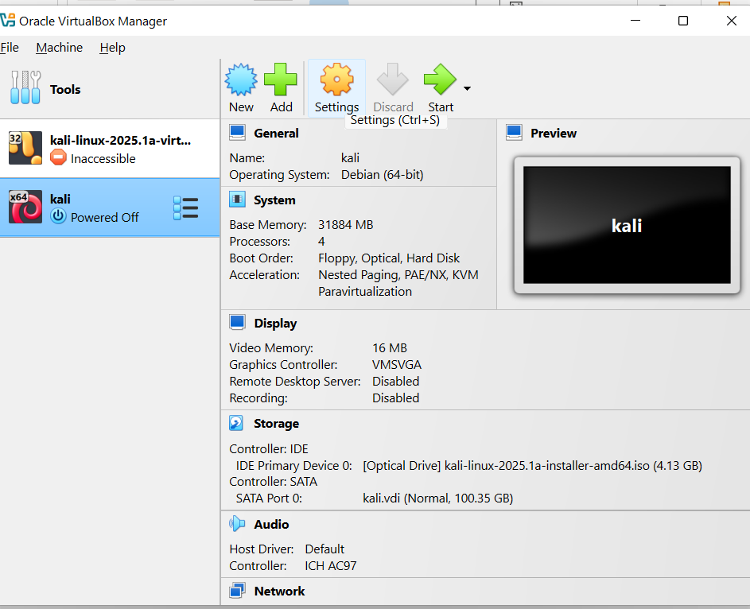
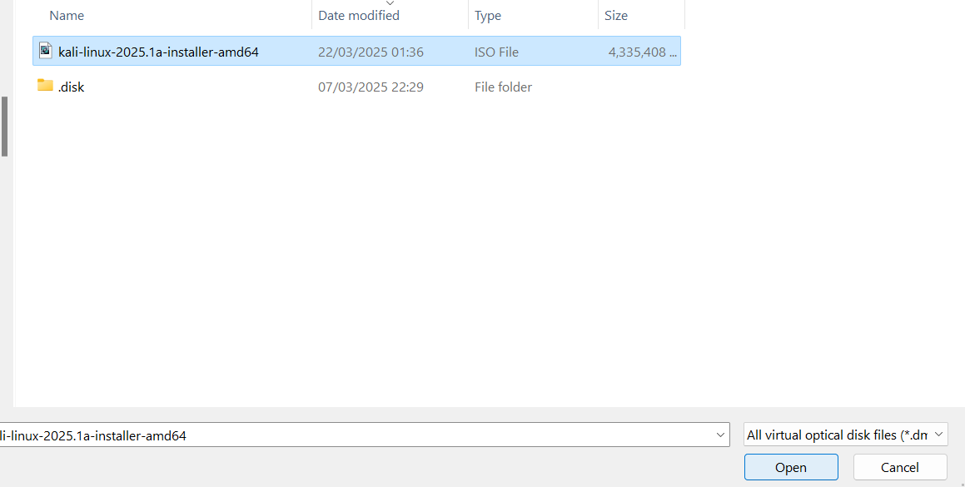
Recap:

Slide 45
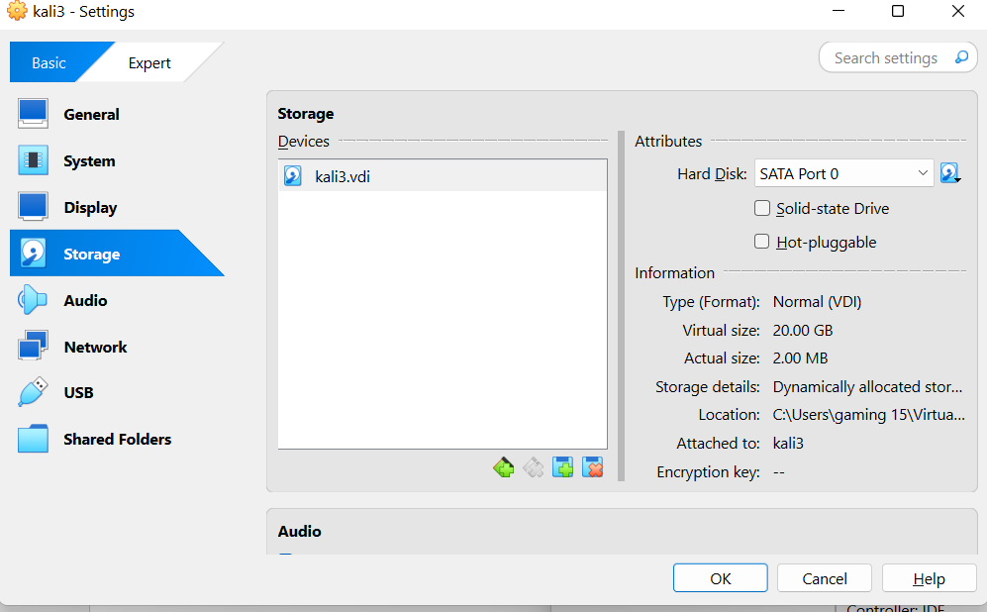
Lab 4 Structure and Step-by-Step Instructions
If there is no Controller Part in the Storage section:
Click the small disc icon with a green + (bottom left of the Storage Tree).
Choose “Add Optical Drive” → then select “Choose a disk file…”.
Locate and select: kali-linux-2025.1a-installer-amd64.iso.

Slide 46
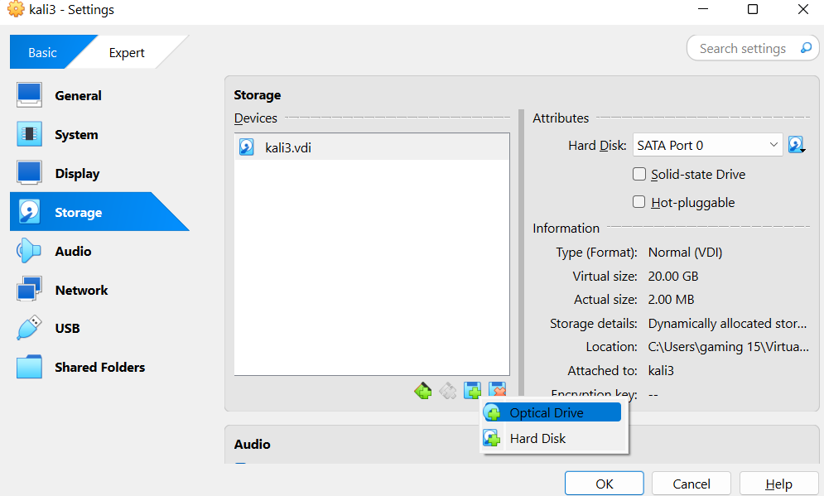
Lab 4 Structure and Step-by-Step Instructions
If there is no Controller Part in the Storage section:
Click the small disc icon with a green + (bottom left of the Storage Tree).
Choose “Add Optical Drive” → then select “Choose a disk file…”.
Locate and select: kali-linux-2025.1a-installer-amd64.iso.

Slide 47
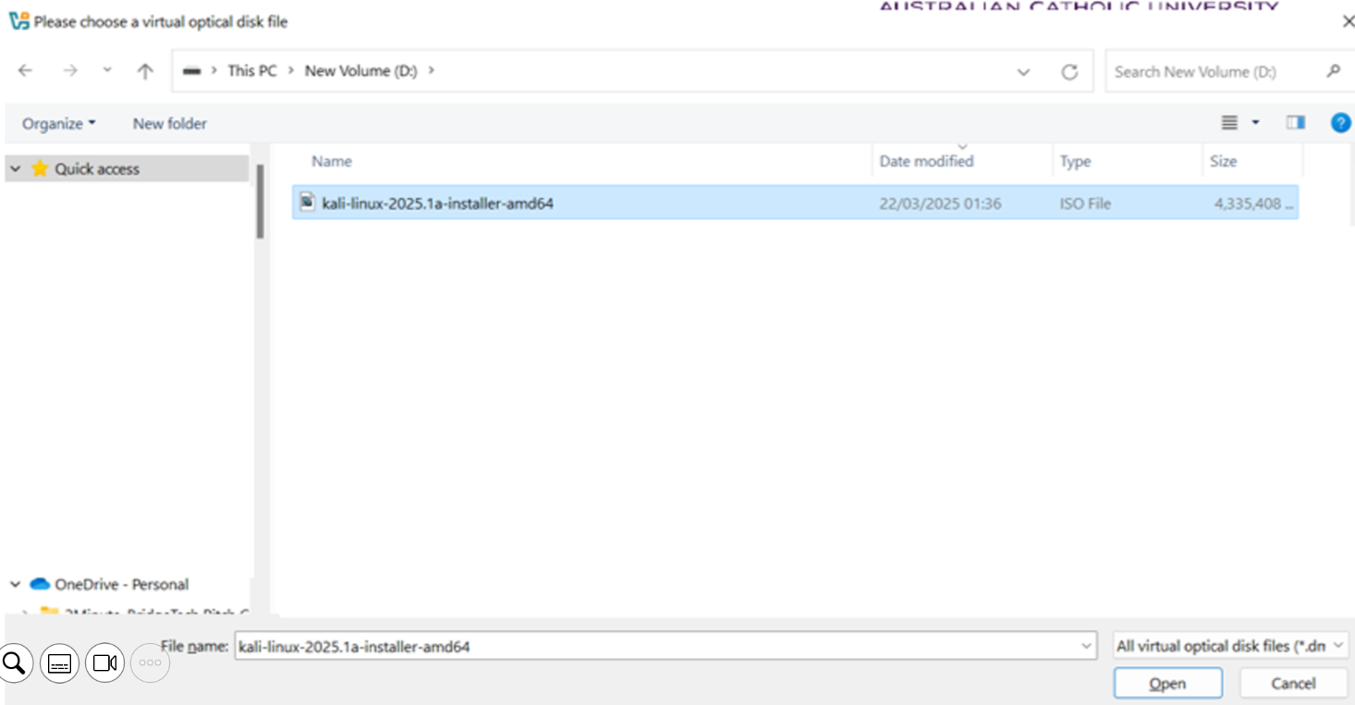
Lab 4 Structure and Step-by-Step Instructions
If there is no Controller Part in the Storage section:
Click the small disc icon with a green + (bottom left of the Storage Tree).
Choose “Add Optical Drive” → then select “Choose a disk file…”.
Locate and select: kali-linux-2025.1a-installer-amd64.iso.

Slide 48
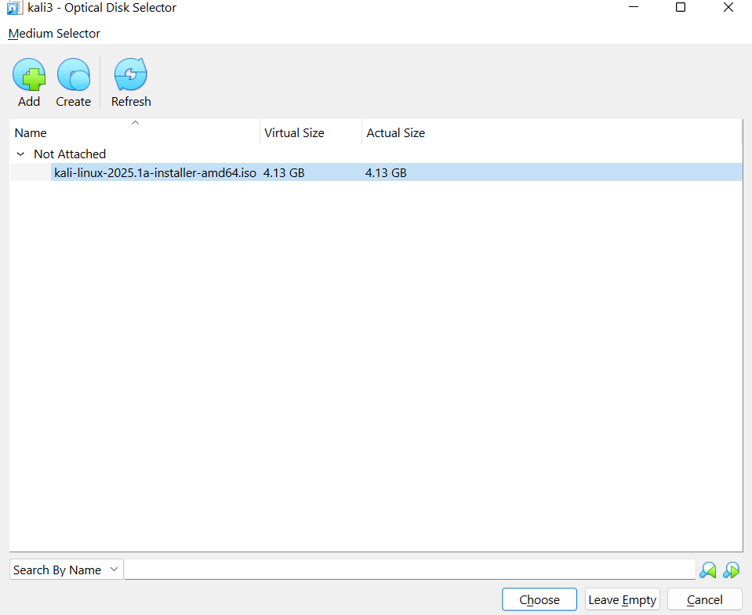
Lab 4 Structure and Step-by-Step Instructions
If there is no Controller Part in the Storage section:
Click the small disc icon with a green + (bottom left of the Storage Tree).
Choose “Add Optical Drive” → then select “Choose a disk file…”.
Locate and select: kali-linux-2025.1a-installer-amd64.iso.

Slide 49
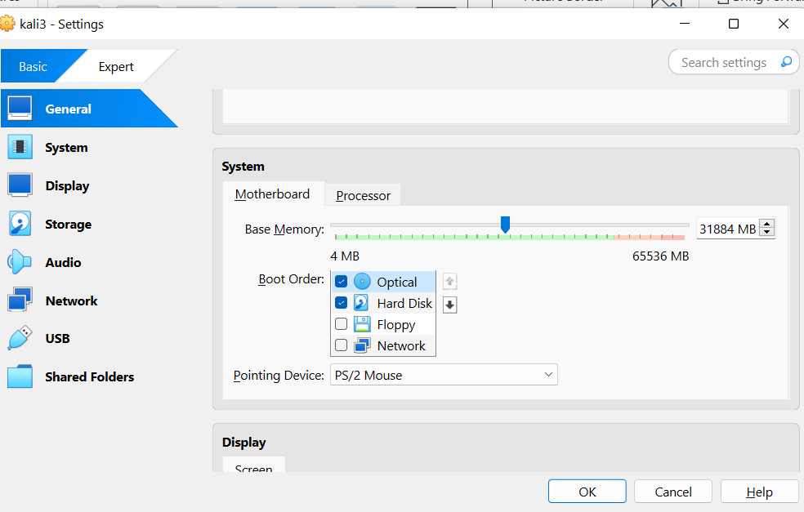
Lab 4 Structure and Step-by-Step Instructions
Boot Order Section:
Navigate to the System tab → go to Boot Order.
Ensure Optical is checked and placed above Hard Disk.
Uncheck Floppy and Network

Slide 50
Lab 4 Structure and Step-by-Step Instructions
Once we Click on Ok, all savings will be saved.
Now we can start our VM. The Kali Linux installer should be loaded.

Slide 51
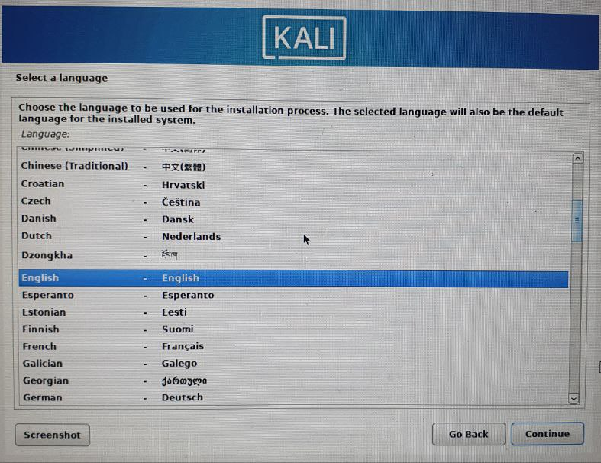
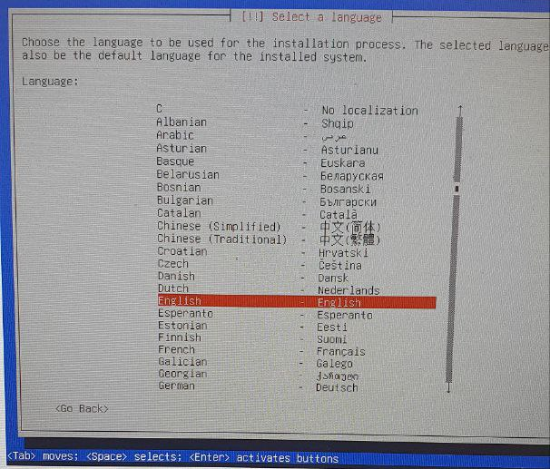
Recap: Then we,
selected Language (English)
selected Location
configured Keyboard Layout
If it asks for host name by default is it kali
Domain name → leave it blank
Full name of new user → e.g., kali
Graphical Installation
Normal Installation

Slide 52

Recap: Then we,
selected Language (English)
selected Location
configured Keyboard Layout
If it asks for host name by default is it kali
Domain name → leave it blank
Full name of new user → e.g., kali
Graphical Installation
Normal Installation

Slide 53

Lab 4 Structure and Step-by-Step Instructions
Recap: We selected "Detect disks" → Enter → Continue as installer guides us.
Then "Install the base system".
Then "Configure the package manager".
Then "Install the GRUB boot loader".
Then "Finish the installation".

Slide 54

Lab 4 Structure and Step-by-Step Instructions
Reinstall Kali (if needed) If after rebooting we land in BusyBox shell like this:
It is advisable to reinstall Kali Linux using the official ISO from kali.org.
Be sure to choose the full desktop installation (XFCE or GNOME) during setup.

Slide 55
Response to Student’s Question
Hi Farshid, I hope this message finds you well. I am reaching out to seek your assistance regarding an issue I am facing with Lab 4 for Week 8. I need to run Kali Linux for the lab, but I recently switched to macOS and am having difficulty setting up the Kali Linux environment. My research indicates that running Kali Linux on this OS may not be feasible. Could you please provide me with any possible solutions? If there are alternative software options available for macOS that would work for the lab, I would be happy to consider those as well. Thank you for your help!

Slide 56
Response to Student’s Question
Dear Learner,
Thank you for reaching out, and I hope you're settling in well with your new macOS setup.
Yes, Kali Linux can absolutely run on macOS —students can use it with VirtualBox for macOS or UTM (for Apple Silicon chips).
There are two recommended solutions:

Slide 57
Response to Student’s Question
Option 1: Use VirtualBox (Intel Mac) If your Mac has an Intel processor, you can continue using VirtualBox:
Download the Kali Linux ISO (Installer) version from the official Kali Downloads page. (suitable for Intel-based Macs running VirtualBox)
Set it up as a new VM in VirtualBox.
Follow the same steps provided for Windows users in the Week 8 lab guide.
Make sure to choose the "Installer" ISO for your architecture (amd64 for Intel Macs).
X Do not use the Live or NetInstaller versions for lab-based VirtualBox installation.

Slide 58

Response to Student’s Question
You should download the Installer Image for x86_64 architecture, which is compatible with VirtualBox on Intel Macs.
Link to download (Installer Image): https://www.kali.org/get-kali/#kali-installer-images

Slide 59
Response to Student’s Question
choose x86_64 (not Apple Silicon), then download the Installer ISO file.
This version allows full installation with customization via VirtualBox.

Slide 60
Response to Student’s Question
If you are using an Apple Silicon (M1, M2, M3) Mac:
VirtualBox may not work properly. In this case, option 2 is recommend:
Download UTM from https://mac.getutm.app/
Then use the ARM64 image from this page: https://www.kali.org/get-kali/#kali-arm

Slide 61

Response to Student’s Question
Option 2: Use UTM (Apple Silicon/M1/M2/M3 chips) If you are using an M1/M2/M3 Mac, VirtualBox may not work as expected. In that case:
Download and install UTM from https://mac.getutm.app/
Use a pre-built Kali ARM image from Kali ARM images.
Import it into UTM and start your Kali environment.

Slide 62
Response to Student’s Question
Let me know what chip your Mac uses (Intel or Apple Silicon), and I’d be happy to guide you through setup based on that.
Warm regards, Dr. Farshid Keivanian Lecturer - ITEC614

Slide 63

Lab 4 Structure and Step-by-Step Instructions
Kali Linux is now ready to use.

Slide 64
Lab 4 Structure and Step-by-Step Instructions
Hash functions are cryptopgraphic algorithms that input messages to generate a fixedsize and unique string output (the hash). Hash functions are characterized by their speed of computations
and difficulty of reversibility. It is usually used to verify whether a message in transit
or in storage has been modified or not because even the smallest change done to the input
data yields a completely different hash. In this lab, we use OpenSSL to generate and verify hashes,
other tool are available.
Next Step: Please follow the instructions on Canvas:
Create a text file
Name it: student_id.txt
Add the provided text (about hash functions).
Save it in the home directory.
Step 3: Open Terminal.
To create a text file in Kali Linux, open the Terminal and type mousepad student_id.txt to launch a basic editor. Type the provided content, then save the file in the default /home directory.

Slide 65
Lab 4 Structure and Step-by-Step Instructions
You create a plain text file named student_id.txt (e.g. 12345.txt) using any text editor like Mousepad in Kali.
Save it in the home directory.
The content about hash functions should exactly match the provided text.
Explanation: This forms the base input to test hash consistency. The file will be saved in /home.

Slide 66
Terminal Commands to Use
Open Terminal: Right-click anywhere on the desktop and choose “Open Terminal Here”, or
Press Ctrl + Alt + T on your keyboard.
Once the terminal is open and we're in the home directory (~), type these commands:
Check file content
cat student_id.txt

Slide 67

Check file content
Type cat student_id.txt to check the contents of the student_id.txt file.
This verifies that your file exists and its contents are readable.
Explanation: Use this step to double-check that the content hasn’t changed due to formatting. If cat returns the full text, our file is correct.

Slide 68
Generate Initial MD5 Hash
After executing cat student_id.txt, we are expecting to see:
Hash functions are cryptographic algorithms that input messages to generate a fixedsize and unique string output (the hash). Hash functions are characterized by their speed of computations and difficulty of reversibility. It is usually used to verify whether a message in transit or in storage has been modified or not because even the smallest change done to the input data yields a completely different hash. In this lab, we use OpenSSL to generate and verify hashes, other tool are available.

Slide 69
Generate Initial MD5 Hash
Generate MD5 hash
openssl md5 student_id.txt
Each command will print a hash string — if you change anything in the file and re-run these, the hash will change. This is the core concept of file integrity checking.

Slide 70

Generate Initial MD5 Hash
Hash the text file using MD5 hashing algorithm to generate a hash of the text file. Use the command openssl md5 student_id.txt
Observe the output on your screen. What did you observe?
This generates a unique fingerprint based on our text file.
Explanation: Any small change in the file (even one word or space) will completely change the hash — demonstrating hash sensitivity.

Slide 71

Modify the Text File
Modify the text file by changing the first “Hash functions” to “Integrity algorithms” and then save.
Change “Hash functions” to “Integrity algorithms” in the same file and save.
Explanation: This tests whether the MD5 hash changes even with minimal edits — and it should. Our updated file content will be shown with the new header.

Slide 72
Recalculate MD5 Hash
Observe the output. What did you observe? Is the new hash different than previous one? How?
Explanation: This should generate a completely different hash compared to previous. This demonstrates why even small modifications break hash consistency.

Slide 73
Test Stronger Hash
C. Generate SHA-1 hash
openssl sha1 student_id.txt

Slide 74
Test Stronger Hash
10. SHA-1 and SHA-2 algorithms are stronger that MD5 hashes. Generate SHA-1 has of the file using command openssl sha1 student_id.txt. Observe the output of the algorithm. What did you observe?
Explanation: SHA-1 is stronger than MD5 and creates a longer hash. We can also experiment with:
openssl sha256 student_id.txt

Slide 75
SHA-2 Research
Use Google to explore the differences between SHA-1 and SHA-2 (like SHA-256).
Explanation: SHA-2 algorithms are considered more secure because they produce longer hashes and resist collision attacks better than SHA-1.

Slide 76
Conclusion – Reflect on Your Learning
In this lab, we’ve learned:
How hash functions work and why they’re essential for cybersecurity.
The impact of even the smallest changes in input on the resulting hash.
The difference between MD5, SHA-1, and stronger SHA-2 hashes.

Slide 77
Conclusion – Reflect on Your Learning
Your Task: For each step, note your observations:
What hash value did you get?
How did the value change when the file was modified?
Which algorithm seems stronger? Why?
This reflection will deepen your understanding and help you prepare for assessments or interviews in cybersecurity roles.

